Slide 1
Activity 4: Upload a Patient and DiagnosticReport to the SmartHealthIt R4 FHIR Patient Server
Download test files
Upload Patient
Upload DiagnosticReport
View Uploaded Patient in SMART on FHIR Application

Slide 2

Most of the Concepts We Will Discuss Are Trademarked
Notes:
Many of the concepts included in this presentation are trademarked including those shown here.

Slide 3
Introduction

Slide 4
Introduction
Upload a Patient and DiagnosticReport to the SmartHealthIt FHIR Patient R4 Server
Postman is required for this activity
Test patients will be provided
We will use the SmartHelthIt FHIR Patient R4 Server
The smart-on-fhir-examples application URL will be provided during the demonstration (the URL changes as AWS assigns a new IP address every time the server is restarted)
We will use the SmartHealthIt sandbox to simulate an EMR (https://launch.smarthealthit.org/) when we view our uploaded Patient

Slide 5
Upload a Patient FHIR Resource

Slide 6
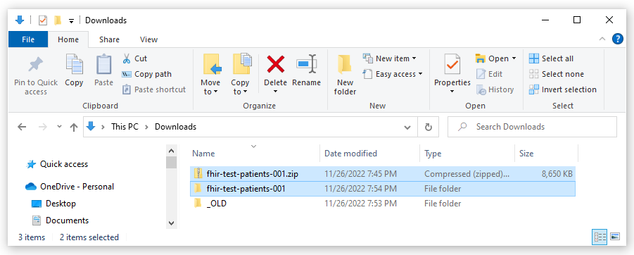
Download and Extract the Test Files Zip File
A URL will be provided for the zip file of test patient resources
Download and extract this file

Slide 7
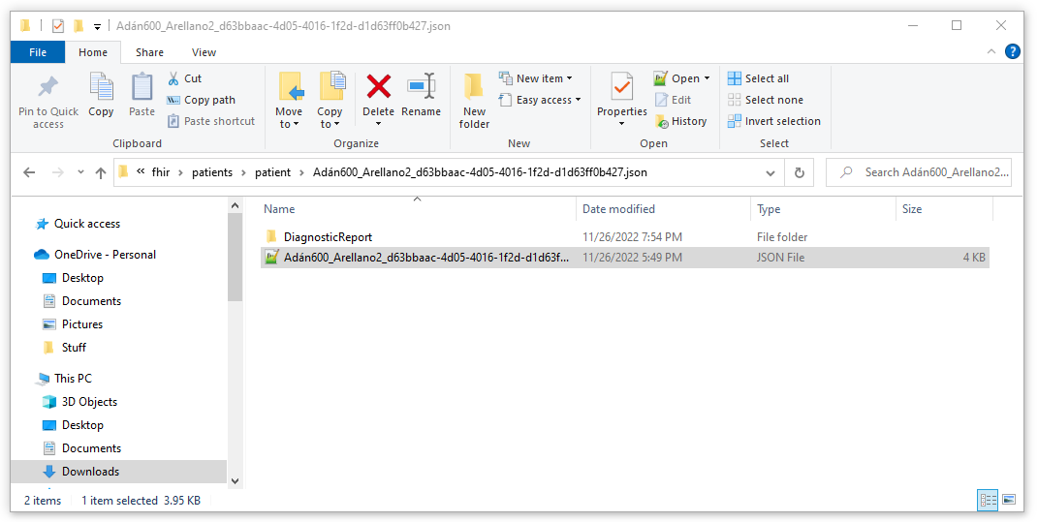
Open a Patient Resource File
Open <zip>/patients/patient/
Open one of the folders (each folder represents a patient)
Open the .json file in the <zip>/patients/patient/<id>/patient file
Copy the contents of this file into a Postman request

Slide 8
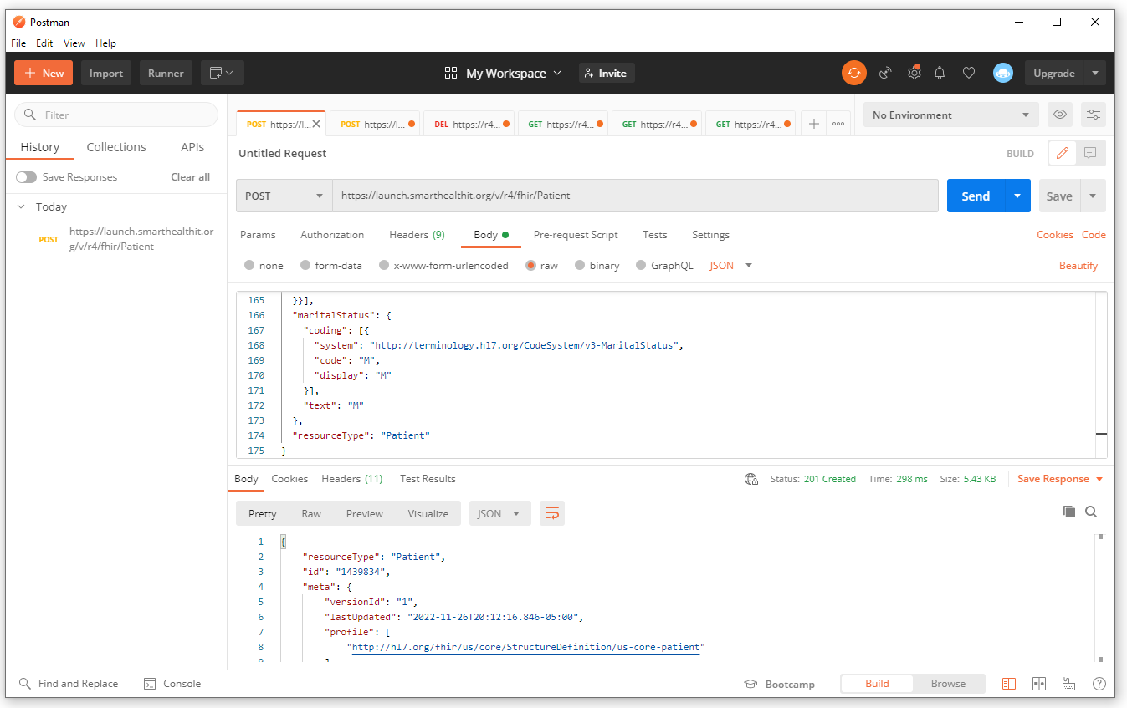
Post the Patient to the SmartHealthIt R4 Server Using Postman
In Postman, select POST
Enter the URL as: https://launch.smarthealthit.org/v/r4/fhir/Patient
Paste the contents of the Patient file into the Body of the request
Press Send
Copy and Save the ID of the newly created patient

Slide 9
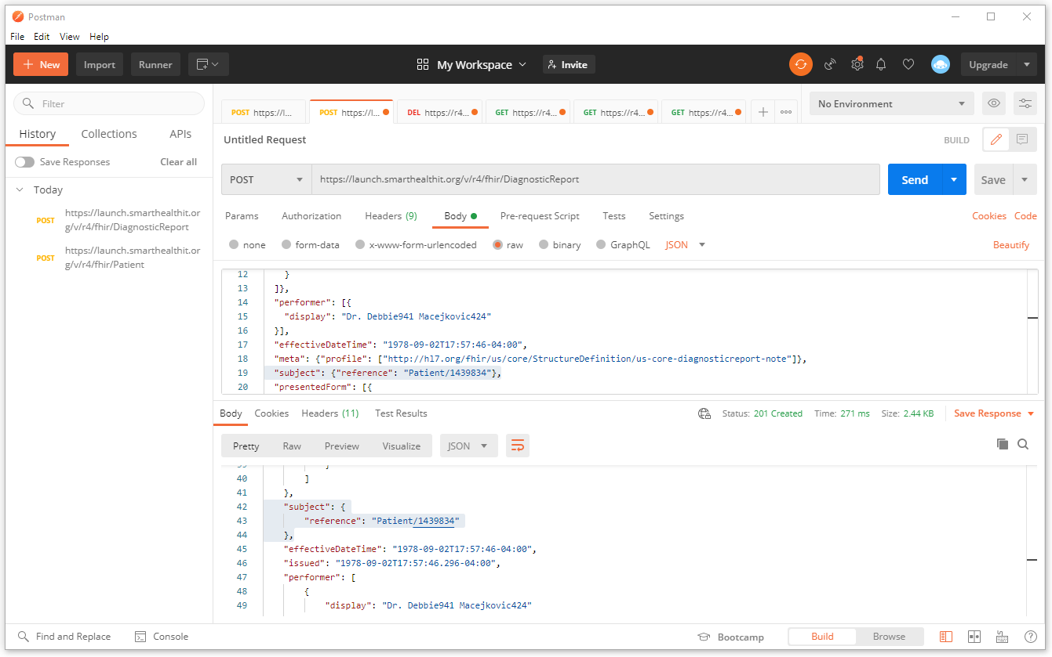
Post the DiagnosticReport to the SmartHealthIt R4 Server
In Postman, select POST
Enter the URL as: https://launch.smarthealthit.org/v/r4/fhir/Patient
Paste the contents of the DiagnosticReport file into the Body of the request
Change the “subject” to point to the id of the newly created Patient
Press Send
Copy and Save the ID of the newly created DiagnosticReport

Slide 10
View Our Uploaded Patient in a SMART on FHIR Application

Slide 11
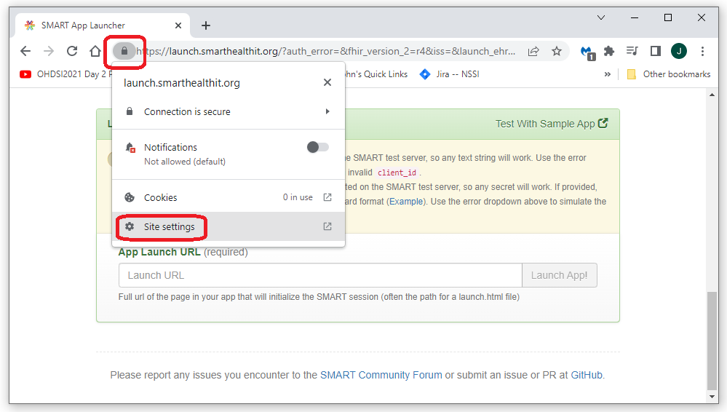
Enable mixed http and https for launch.smarthealthit.org
Open the site settings menu
Since the SmartHealthIt sandbox submits the request to the SMART on FHIR application and our application does not currently support https, we need to tell Chrome that we would like to allow launch.smarthealthit.org to send both https and http content
Do this by opening launch.smarthealthit.org in a Chrome browser, then selecting the lock icon next to the url

Slide 12
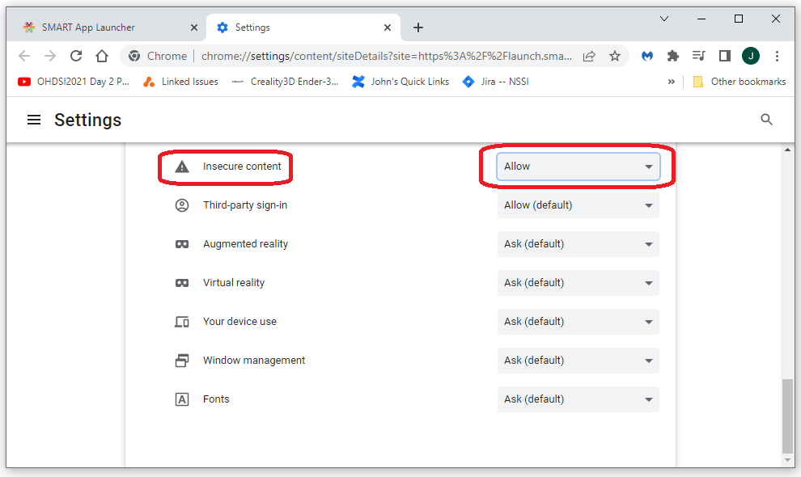
Enable mixed http and https for launch.smarthealthit.org
Open the site settings menu
Scroll down to the Insecure content setting and select Allow
This will allow our http site to be accessed from the https launch executed by the SmartHealthIt sandbox

Slide 13
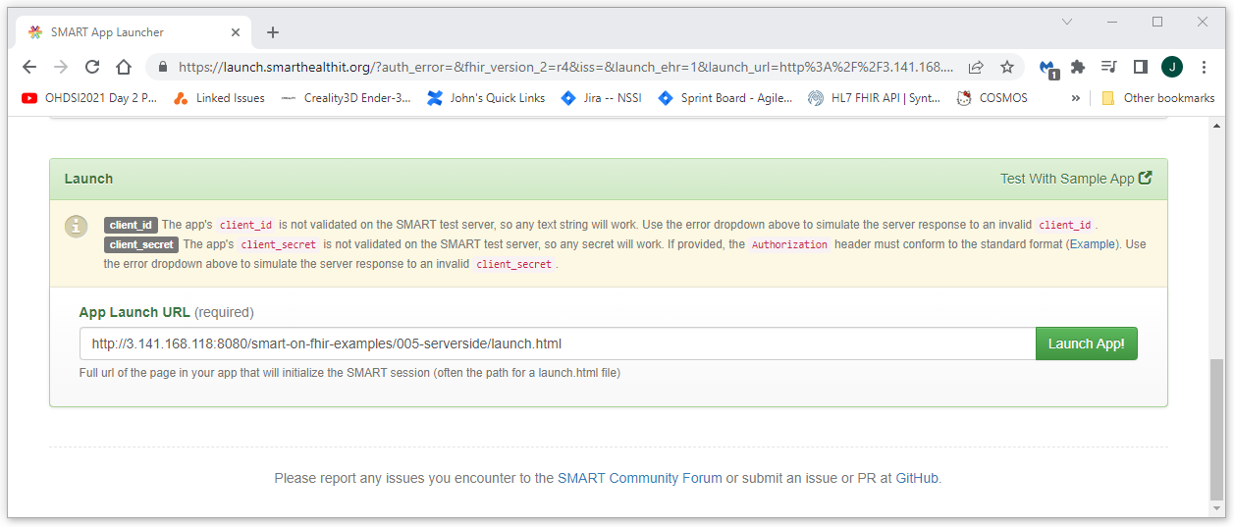
Launch our published SMART on FHIR application from an EMR
Navigate to the SmartHealthIt sand box at https://launch.smarthealthit.org/
Enter the URL for our app and launch: http://<host-ip>/smart-on-fhir-examples/005-serverside/launch.html
Press the “Launch App!” button

Slide 14
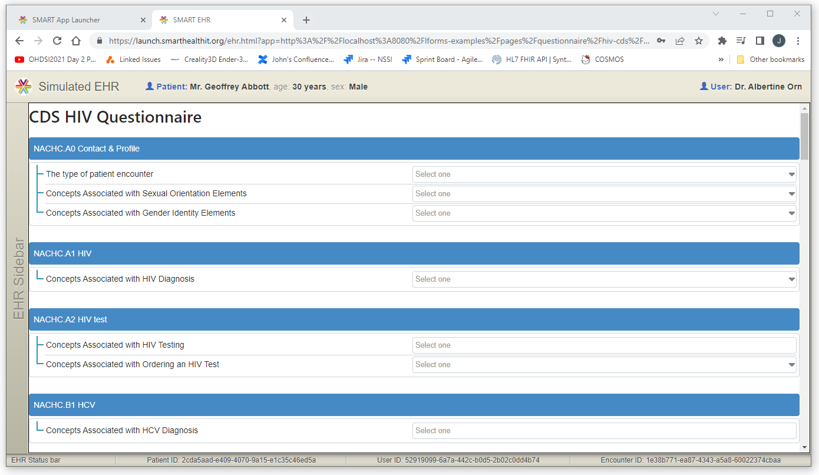
Success!!!
After logging in and selecting a patient, you should get a response from our publicly available SMART on FHIR Application that looks something like this

Slide 15


